Slide 1


The Use Case
January 7, 2015
Presenters name, Title - Date

Slide 2
What we are doing today
We will look at an actual real world use case
We will discuss what we would need to solve the problem.
We will cover the material in the lectures for the components we will use.
We will do labs to learn how to use those components in the context of the use case.

Slide 3
The Use Case
January 5, 2015

Slide 4
The Client’s Problem
The Client has an Association mandated auto adjudication goal of 92%.
Currently 8 to 12% of claims coming from the clearing house have errors in the billing provider ID caused by their converting from legacy and from their acquiring new networks.
Correcting the input data using a crosswalk from legacy to Facets provider ID could significantly increase the rate and bring them into compliance.

Slide 5
Additional information
The Client has defined a structure for claim numbers that imparts meaning to them. This cause claim numbers to be a rare resource.
The client does not want claims to PEND in XC. Instead they want claims that cannot be fixed to be dropped before the enhanced keyword load.
They may want a staging area where someone (human or robot) could do additional repair of the claims before final reject.

Slide 6
Additional information
The Client must report back to the provider sufficient information to identify a rejected claim and so that it can be re-submited.
The client may want to add other filtering rules to this process.

Slide 7
High level flow
January 15, 2015

Slide 8
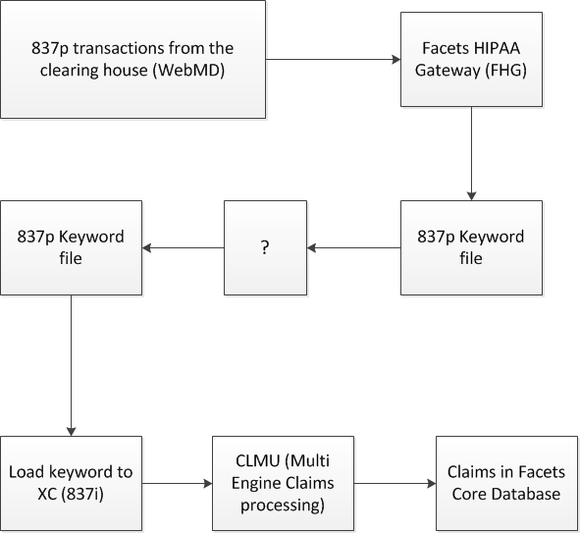
High level flow.

Slide 9
What does a keyword file look like?
January 15, 2015

Slide 10
Keyword Sample

Slide 11
What will we need to solve this problem.
January 15, 2015

Slide 12
Solution Components?
Are there batch components?
Do we need custom tables?
How about online?
Maybe a Web interface?

Slide 13
Q & A
January 15, 2015

